Slide 1
Python _Capstone Project
Presented By
M.Shilpa

Slide 2
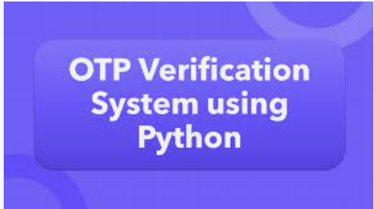
Project Title: OTP Verification System

Slide 3

Problem statement
Project requirements
IDE tools
Used libraries
Process Flow
Explanation
Result

Slide 4
Problem Statement:
Developing an OTP (One-Time Password) verification system in Python.
The system should generate a 6-digit OTP .
Send The otp to the user's email address for verification.
Upon receiving the OTP, the user should enter it into the system for validation.
If the entered OTP matches the generated OTP, access should be granted; otherwise, access should be denied.

Slide 5
Project Requirements:
Implement a function to generate a 6-digit OTP randomly.
Develop a function to simulate sending the OTP to the user's email address.
Create a function to prompt the user to enter the OTP received in their email.
Implement a function to verify if the entered OTP matches the generated OTP.
Ensure proper error handling and user-friendly prompts throughout the system.
Allow the user to retry OTP entry in case of incorrect input.

Slide 6



Slide 7

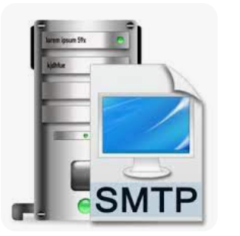




Slide 8
SMTP(Simple Mail Transfer prtocol) :
This library allows to send emails
Email :
email library for creating and formating
email messages.
Random:
random module in python used to
generate random numbers.
Tkinter:
Tkinter is a standard GUI library in python used to create desktop applications with graphical interfaces.it provides set of tools for building GUIs.

Slide 9
Process flow :
Starting the session
Asking user for entering valid email
Generating 6-digit random OTP
Drafting email body
Adding 6-digit random OTP to email
Sending the email
Asking user to entering received OTP
Verifying the entered OTP with system
Providing access, if entered OTP is correct .
If entered otp is wrong providing 3-attempts for entering correct OTP.

Slide 10
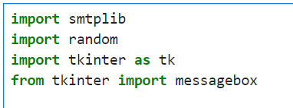

Importing the required libraries.
Function to generate a random 6-digit OTP.
Function to send OTP via Gmail.
Connect to the Gmail SMTP server.

Slide 11


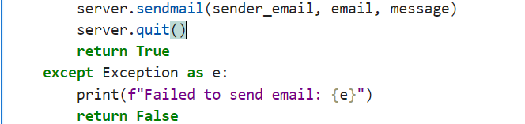
Login to your Gmail account.
Create the email content.
Send the email.

Slide 12
Create the GUI Class for OTP Verification.
Define the OTP App class to set up the GUI components and handle the OTP verification logic.
Implemente the Main Execution Block.
Write the main block to generate the OTP, send it via email, and
start the GUI application.
Run the Script:
1.Generate OTP: A 6-digit OTP is generated.
2.Send OTP: The OTP is sent to the specified email address.
3.Launch GUI: A Tkinter window is opened for the user to enter the OTP.
4.Verify OTP: The user enters the OTP, and it is verified against the generated OTP. If correct, access is granted; otherwise, the user is allowed up to three attempts before the application exits.

Slide 13

Result:

